Slide 1


Slide 2
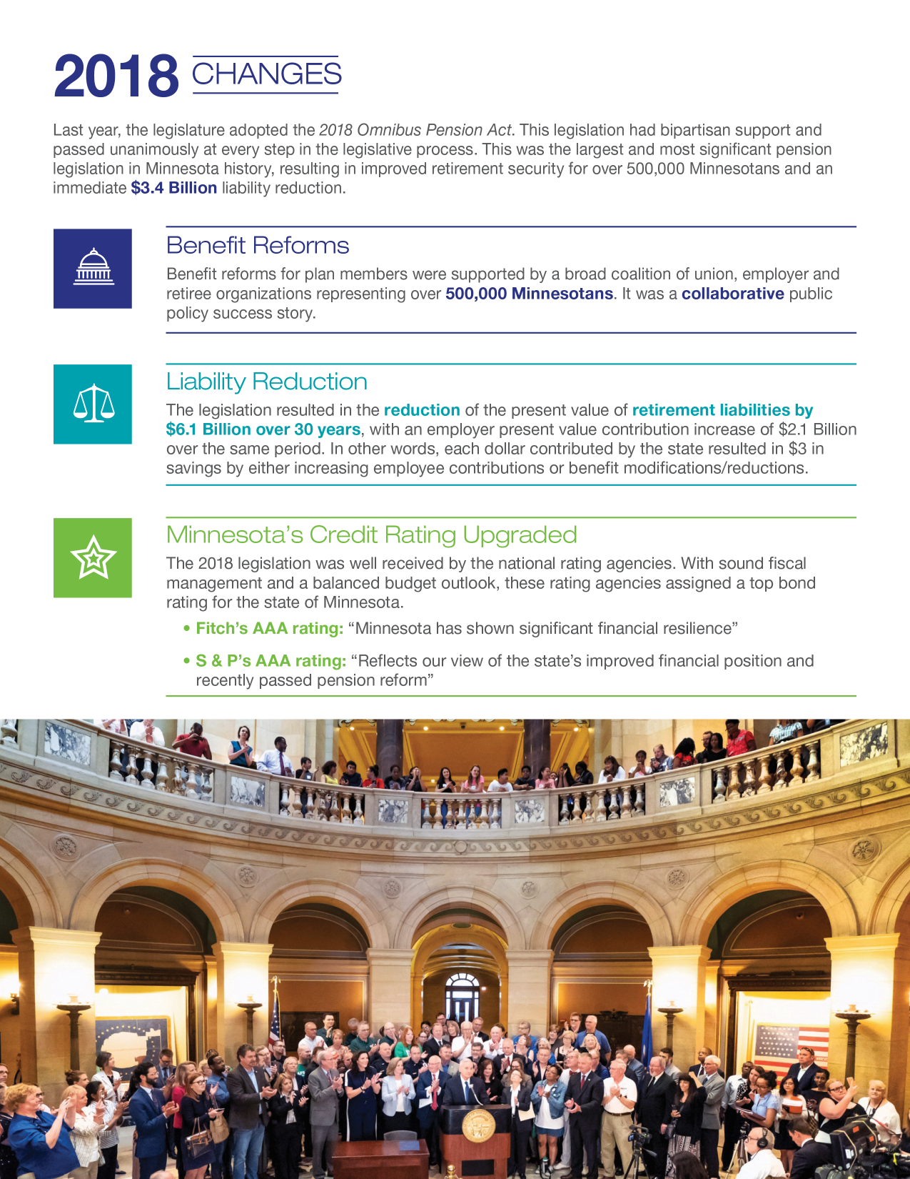
AGENDA
  2018 Pension Bill
    Why?
    Summary of Reforms
    Impact & Minnesota Experience
  Overview of Minnesota Pension Plans
    Role of Legislature
    Governance
  Plan Overview & Funding Information
  Erin Leonard, Minnesota State Retirement System
  Doug Anderson, Public Employees Retirement Association
  Jay Stoffel, Teachers Retirement Association
  Jill Schurtz, St. Paul Teachers’ Retirement Fund Association

Slide 3
2018 LEGISLATION- WHY?
Life Expectancies Increased: A comprehensive study in 2014 resulted in a more aggressive forecast for mortality improvements. Use of the more conservative assumption increased liabilities.
Fun Fact: People born in the following states have the longest life expectancies in the USA: Hawaii (81.3), Minnesota (81.1), and Connecticut (80.8).
Investment Return Expectations: Investment professionals and actuaries recommended a more conservative investment assumption of 7.5%. Assuming lower investment expectations increases liabilities to the retirement plan.

Slide 4
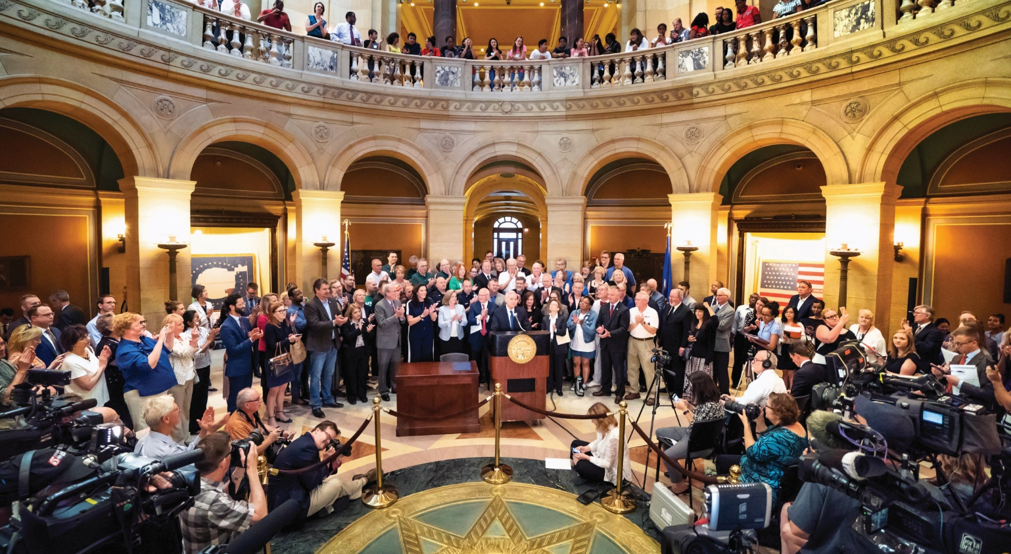
2018 CHANGES- ALL PLANS
Reduced investment rate of return assumption to 7.5%
Eliminated future deferred augmentation
Increased the cost to retire early
Adopted new 30-year amortization period

Slide 5
2018 CHANGES- FUNDING
Employee & Employer contribution increases
  Included in appropriations or E-12 formula
  Contributions are phased-in for most plans
    MSRS General
    MSRS Correctional Plan
    MSRS State Patrol Plan
    PERA Police & Fire
    TRA
    SPTRFA
  Supplemental Employer contributions
    MSRS Correctional
    MSRS State Patrol
Direct Plan appropriations
  PERA Police & Fire
  SPTRFA

Slide 6
2018 CHANGES- RETIREE COLA
Reduced COLA
  MSRS- General
  MSRS- Correctional
  TRA
  SPTRFA
Modified COLA structure
  PERA- General
  PERA- Correctional
Remove COLA trigger (most plans)
Delayed COLA beginning 2024 until full retirement age (except public safety plans)

Slide 7
2018 CHANGES- IMPACT
Bipartisan support
  Passed unanimously at every phase of legislative process
Supported by broad coalition of unions, employers, and retiree organizations
Total savings $6.1 Billion over 30 years
  Immediate liability reduction of $3.4 Billion
  State contribution of $1 for every $3 in employee contributions and benefit reductions
Improved retirement security for over 500,000 Minnesotans

Slide 8
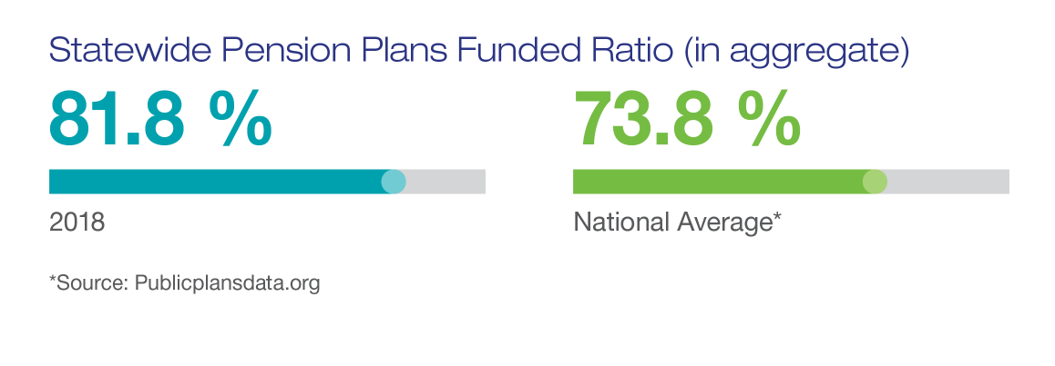
2018 CHANGES- IMPACT
ALL plans with sustainability measures included in the 2018 Omnibus Pension bill expected to be fully funded within 30 years

Slide 9
2018 CHANGES- IMPACT
Minnesota’s credit rating upgraded
  The 2018 legislation was well received by the national rating agencies.

Slide 10
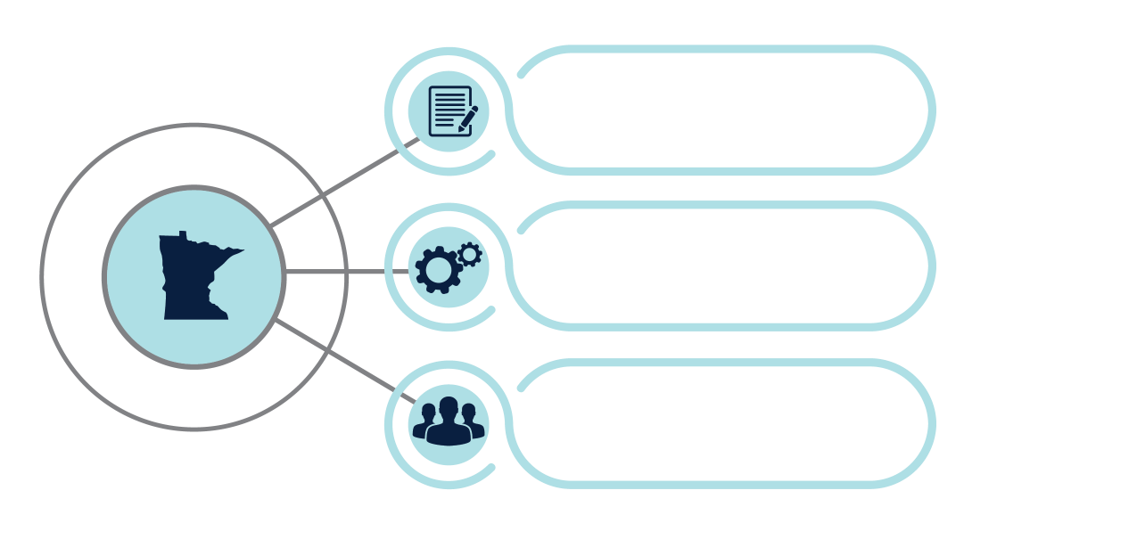
Governance
Each system has Board of Directors/Trustees
  Fiduciary responsibility to act in the exclusive interest of the members and beneficiaries of the plans, the taxpayers, and the State of Minnesota.
Oversee administration of retirement plans
Consider disability & other appeals
Set Policies, approve budget & advise Executive Director
The Legislature under Minnesota Statute defines:
  Plan provisions (plan eligibility, benefits & COLAs)
  Contribution rates
  Amortization methods (period etc.)
  Investment return assumption
  Investment guidelines

Slide 11

General Plan Overview
(June 30, 2018)
Includes State of Minnesota, Metropolitan Council, University of Minnesota civil service and some Minnesota State university system employees
90.6% Funded
(market value)
  $13.3 Billion Assets
  $1.3 Billion Unfunded Liability
Contributions & Funding Requirements
Employee Contribution* | 6.00%
Employer Contribution* | 6.25%
Additional State Funding | Funding for increased ER Contribution
Total Required Contribution | 11.1%
Contribution Sufficiency | 1.15%
117,388 Members
  51,223 Active
  40,821 Retired
  25,344 Deferred
Assumes fully phased in contributions passed in 2018 Omnibus Pension Bill
$1,729 Avg. Initial Benefit

Slide 12
Correctional Plan Overview
(June 30, 2018)
Includes employees working with offenders in the state correctional system or patients in security hospitals.
74.8% Funded
(market value)
  $1.1 Billion Assets
  $375.6 Million Unfunded Liability
Contributions & Funding Requirements
Employee Contribution* | 9.6%
Employer Contribution* | 14.4%
Supplemental Employer Contribution* | 4.45%
Additional State Funding | Funding for increased ER Contribution
Total Required Contribution | 25.3%
Contribution Sufficiency | 3.15%
10,099 Members
  4,650 Active
  3,259 Retired
  2,190 Deferred
$2,073 Avg. Initial Benefit
Assumes fully phased in contributions passed in 2018 Omnibus Pension Bill

Slide 13
State Patrol Plan Overview
(June 30, 2018)
Includes State Troopers, Conservation Officers, Crime Bureau officers and other state employed peace officers.
78.4% Funded
(market value)
  $729.8 Million Assets
  $200.6 Million Unfunded Liability
Contributions & Funding Requirements
Employee Contribution* | 15.4%
Employer Contribution* | 23.1%
Supplemental Employer Contribution* | 7.0%
Additional State Funding | Funding for increased ER Contribution $1 Million Annual
Total Required Contribution | 40.2%
Contribution Sufficiency | 5.3%
2,070 Members
  921 Active
  1,071 Retired
  78 Deferred
$3,970 Avg. Initial Benefit
State Patrol Members do not contribute to Social Security
Assumes fully phased in contributions passed in 2018 Omnibus Pension Bill

Slide 14
Funding Projections
14

Slide 15
Judges Plan Overview
(June 30, 2018)
Includes elected or appointed judges
53.4% Funded
(market value)
  $201.8 Million Assets
  $176.2 Million Unfunded Liability
Contributions & Funding Requirements
Employee Contribution | 7% or 9%
Employer Contribution | 22.5%
Additional State Funding | $6 Million Annual
Total Required Contribution | 42.4%
Contribution Sufficiency | 0.10%
701 Members
    317 Active
    369 Retired
    15 Deferred
Assumes fully phased in contributions passed in 2018 Omnibus Pension Bill
$5,663 Avg. Initial Benefit

Slide 16
Judges Plan Funding Projections
16

Slide 17
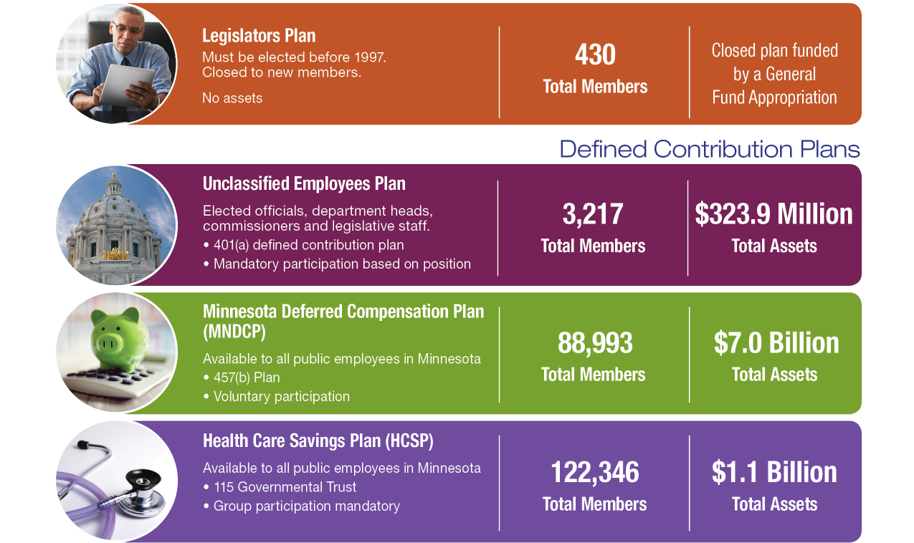
Additional Plans
(June 30, 2018)
Pay as you go funding model

Slide 18

General Plan Overview
(June 30, 2018)
Includes eligible employees of cities, counties, townships, schools, and other entities
79.5% Funded
(market value)
  $21.6 Billion Assets
  $5.5 Billion Unfunded Liability
Contributions & Funding Requirements
Employee Contribution | 6.50%
Employer Contribution | 7.50%
Minneapolis - $31M* | 0.49%
State - $6M* | 0.09%
Total Required Contribution | 13.06%
Contribution Sufficiency | 1.52%
454,665 Members
  153,059 Active
  101,772 Retired
  199,834 Deferred
$37M/year MERF contribution through 2031
$1,275 Avg. Initial Benefit

Slide 19
Police & Fire Plan Overview
(June 30, 2018)
Includes all full-time and certain part-time police officers and firefighters and certain paramedics.
Contributions & Funding Requirements
Employee Contribution* | 11.80%
Employer Contribution* | 17.70%
Minneapolis Police** | 0.99%
Minneapolis Fire** | 0.54%
State*** | 1.80%
Total Required Contribution | 27.23%
Contribution Sufficiency | 5.60%
88.8% Funded
(market value)
  $8.5 Billion Assets
  $1.1 Billion Unfunded Liability
25,197 Members
  11,673 Active
  10,756 Retired
  2,768 Deferred
Assumes fully phased in contributions passed in 2018 Omnibus Pension Bill
** Through 2031, subject to recalculation
*** $9M until both PERA P&F and MSRS HP 90% funded
$4.5M in ‘19 & ’20, $9M/year until 2048 or 100% funded
$4,895 Avg. Initial Benefit
P&F Members do not contribute to Social Security

Slide 20
Correctional Plan Overview
(June 30, 2018)
Includes employees expected to respond to incidents and who are directly responsible for security, custody, and control of confined persons.
97.6% Funded
(market value)
  $680.4 Million Assets
  $16.4 Million Unfunded Liability
Contributions & Funding Requirements
Employee Contribution | 5.83%
Employer Contribution | 8.75%
Total Required Contribution | 14.53%
Contribution Sufficiency | 0.05%
11,150 Members
  3,981 Active
  1,193 Retired
  5,976 Deferred
$1,347 Avg. Initial Benefit

Slide 21
Funding Projections
21

Slide 22




Additional Plans
(June 30, 2018)
Statewide Volunteer Firefighter
For volunteer firefighters who provide service to a municipal fire department or an independent nonprofit firefighting corporation.
4,093
Total Members
$88.6M
Total Assets
Defined Contribution Plan
Exclusively for physicians, elected local governmental officials, city managers, and governmental volunteer ambulance service personnel
7,700
Total Members
$69.8M
Total Assets
Other post-employment benefits (OPEB)
A public entity that creates an actuarial liability to pay OPEB to employees after termination of service may establish a trust used to pay the benefits.
23
Participants
$636.2M
Total Assets
Long-Term Investment Account
Certain cities and counties have the option to invest a portion of their funds with the State Board of Investment in an account managed by PERA.
2
Participants
$3M
Total Assets

Slide 23

Plan Overview
(June 30, 2018)
Includes public and charter school educators (except for member of SPTRFA) and some faculty of Minnesota State.
78.1% Funded
(market value)
  $22.4 Billion Assets
  $6.3 Billion Unfunded Liability
Contributions & Funding Requirements
Employee Contribution* | 7.75%
Employer Contribution* | 8.95%
Additional State Funding | 0.69%
Total Required Contribution | 17.18%
Contribution Sufficiency | 0.21%
197,910 Members
  82,495 Active
  66,104 Retired
  49,311 Deferred
Assumes fully phased in contributions passed in 2018 Omnibus Pension Bill
$2,175 Avg. Initial Benefit

Slide 24
Annual Direct State Funding
Purpose | Annual Appropriation
Merger of Minneapolis Teachers Retirement Fund (2006) • Direct State Aid • State match of Minneapolis city and school district Total for MTRFA merger (Minneapolis city and school district each contribute $2,250,000, a total of $4,500,000, to TRA for the MTRFA merger.) | $12,954,000 2,500,000 $15,454,000
Merger of Duluth Teachers Retirement Fund (2015) | $14,377,000
Amortization State Aid | $1,256,410
Total State of Minnesota | $31,087,410

Slide 25
State Funding for School Districts
Annual appropriations to the Department of Education will cover the higher TRA employer contribution paid by the school districts.
The Dept. of Education makes an allocation to each school district via a pension adjustment in the school aid formula. The allocation to each district is based on it’s TRA covered payroll.
 | FY19 | FY20 | FY21 | FY22 | FY23 | FY24
TRA Employer Contribution Rate | 7.71% | 7.92% | 8.13% | 8.34% | 8.55% | 8.75%
Appropriation to Dept. Education for TRA Districts | $8.9 m | $19.7 m | $31.7 m | $44.4 m | $58.0 m | $ 71.0 m
Source: FY19 – FY23 data is from MN Dept. Education February 2019 forecast projections. FY 24 data is not from MDE but is estimated based on FY23 growth rate.

Slide 26
Funding Projections

Slide 27
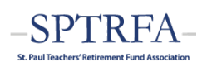
Plan Overview
(June 30, 2018)
Includes licensed teachers and staff of Independent School District No. 625 and some MN State faculty.
63.9% Funded
(market value)
  $1.1 Billion Assets
  $605.6 Million Unfunded Liability
Contributions & Funding Requirements
Employee Contribution* | 7.75%
Employer Contribution* | 9.0% Regular 3.84% Suppl.
Direct State Funding** | $15.7 million
Total Required Contribution | 21.48%
Contribution Sufficiency | 2.75%
12,404 Members
  3,445 Active
  3,914 Retired
  5,045 Deferred
Assumes fully phased-in contributions included in 2018 Omnibus Pension Bill (2.5% ER increase over 6 years/0.25% EE increase in FY ‘23)
** Reflects 1996, 1997, 2014, and 2018 legislation
$1,729 Avg. Initial Benefit (Coord Plan)

Slide 28
Funding Projections
102%
FY19 | FY20 | FY21 | FY22 | FY23 | FY24
$2.28M | $4.65M | $5.32M | $6.07M | $6.84M | $7.71M
Direct State Allocation: $5M
EE Contribution Increase from 7.5% to 7.75% in FY23
FY18 funding & projection
FY17 without pension bill
55%
ER contribution increase funded through annual appropriation to MDE
Source: FY19-23 from MDE November forecast. FY24 data estimated based on FY23 growth rate.

Slide 29
